Slide 1

SHOWWW Stuff Happening on What/ When/ Where
The Line Up:
Chanelle Gonzalez (1-2)
Kyle Stephens (3)
Akhyar Zaman (4)
Sam Spillane (5-7)
Jenna Barkely (Demo)
Ryan Beebe (8-10)

Slide 2
What... is it?
We have created your soon to be favorite place to find out what is happening near you. Our SHOWWW dashboard will help you locate any live music event coming your way.
If you are in the mood to ROCK or sit back and listen to the BLUES, we have you covered with the option to filter by your preferred music genre.
If you are out of town and looking to find the WITCH-HOUSE scene in the area, we can get you dancing by subgenre, too.

Slide 3
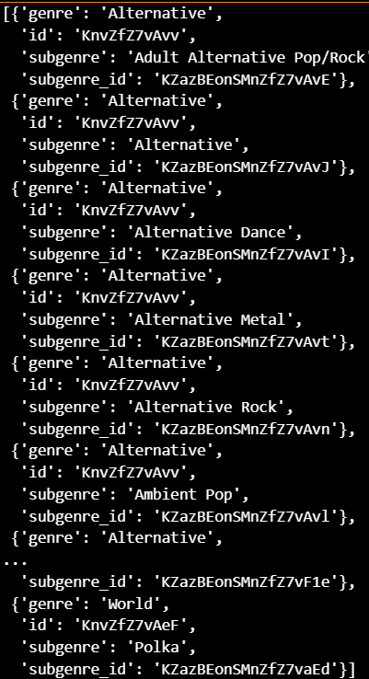
Where… did it come from?
Data Source:
- Ticketmaster API
API Filters:
Greater Los Angeles Area
Current and Upcoming Events
All Music Events

Slide 4
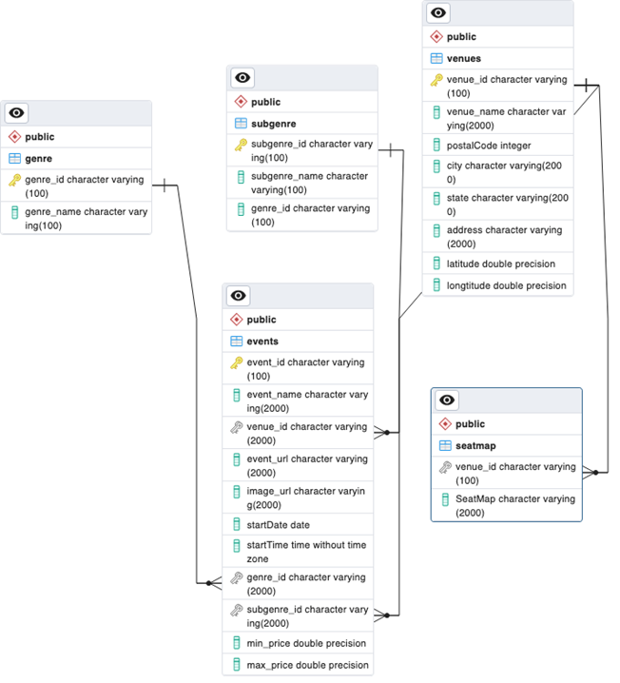
Where… is it stored?
Database:
- SQL/ Postgres
Entity Relationship Diagram:
Genre
Subgenre
Events
Venues
Seat Map

Slide 5
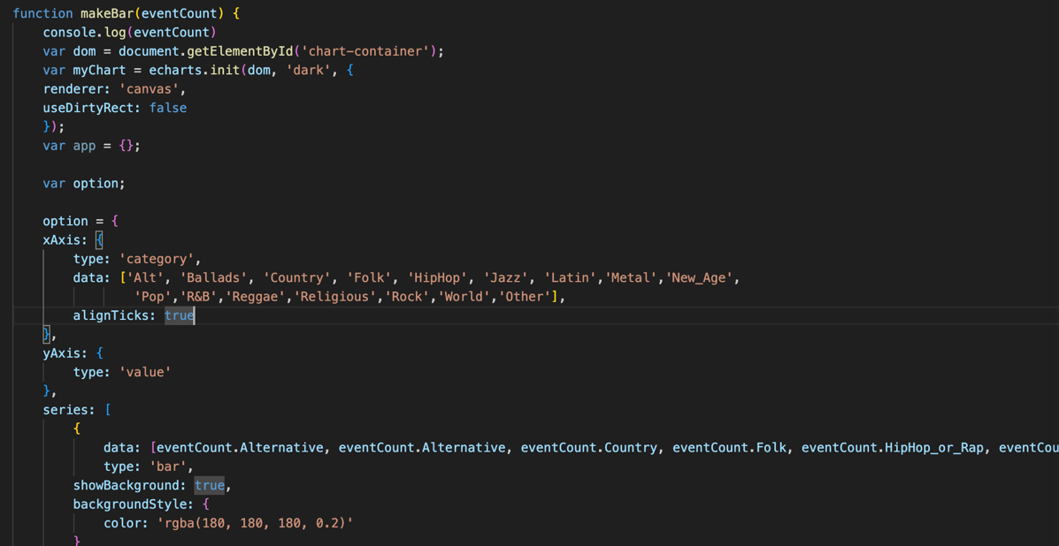



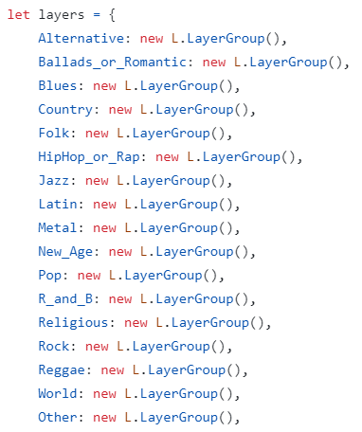
What… new package?
We expanded our minds with analytic visuals from
E-Charts. The package offered a wide variety of charting options. Though we kept it pretty basic, to start.
Due to complexities, we stuck with Leaflet for our mapping needs.

Slide 6
What… does it look like?
Dashboard snapshot

Slide 7
When… should you try it?
RIGHT NOW!
Take it away, Jenna!

Slide 8
When… did we lose it?
We are definitely in Alpha! We ran into quite a few challenges through this development that set us back:
Original plan was built around Eventbrite API, but it depreciated and we had to find an emergency back up, Ticketmaster API.
Ticketmaster limited the amount of data we could collect, so limited to just Los Angeles Area to start.
We had no shortage of technical difficulties.

Slide 9
What… would we do next?
We have some work to do to perfect the functionality of the SHOWWW dashboard before it is ready for showtime:
Expand our data to include all cities through the United States for wider date range.
Develop a better filter to allow for the dashboard to be filtered by subgenre, date range and price range.
Integrate the seat map details where available.
Find way to pull data more frequently than daily, so it’s more up to date

Slide 10
What… questions?
We are here to help.

